Slide 1
POP PUNK IS NOT PUNK
......................................................right?

Slide 2
Problem Statement
Is the language in text posts from the subreddits “Punk” and “PopPunkers” different enough that a classification model can predict which subreddit a post belongs to with an accuracy higher than the baseline?

Slide 3
Overview
What was our data?
What model did we use?
What did we find?
How can we use this information?

Slide 4

Our Data

Slide 5

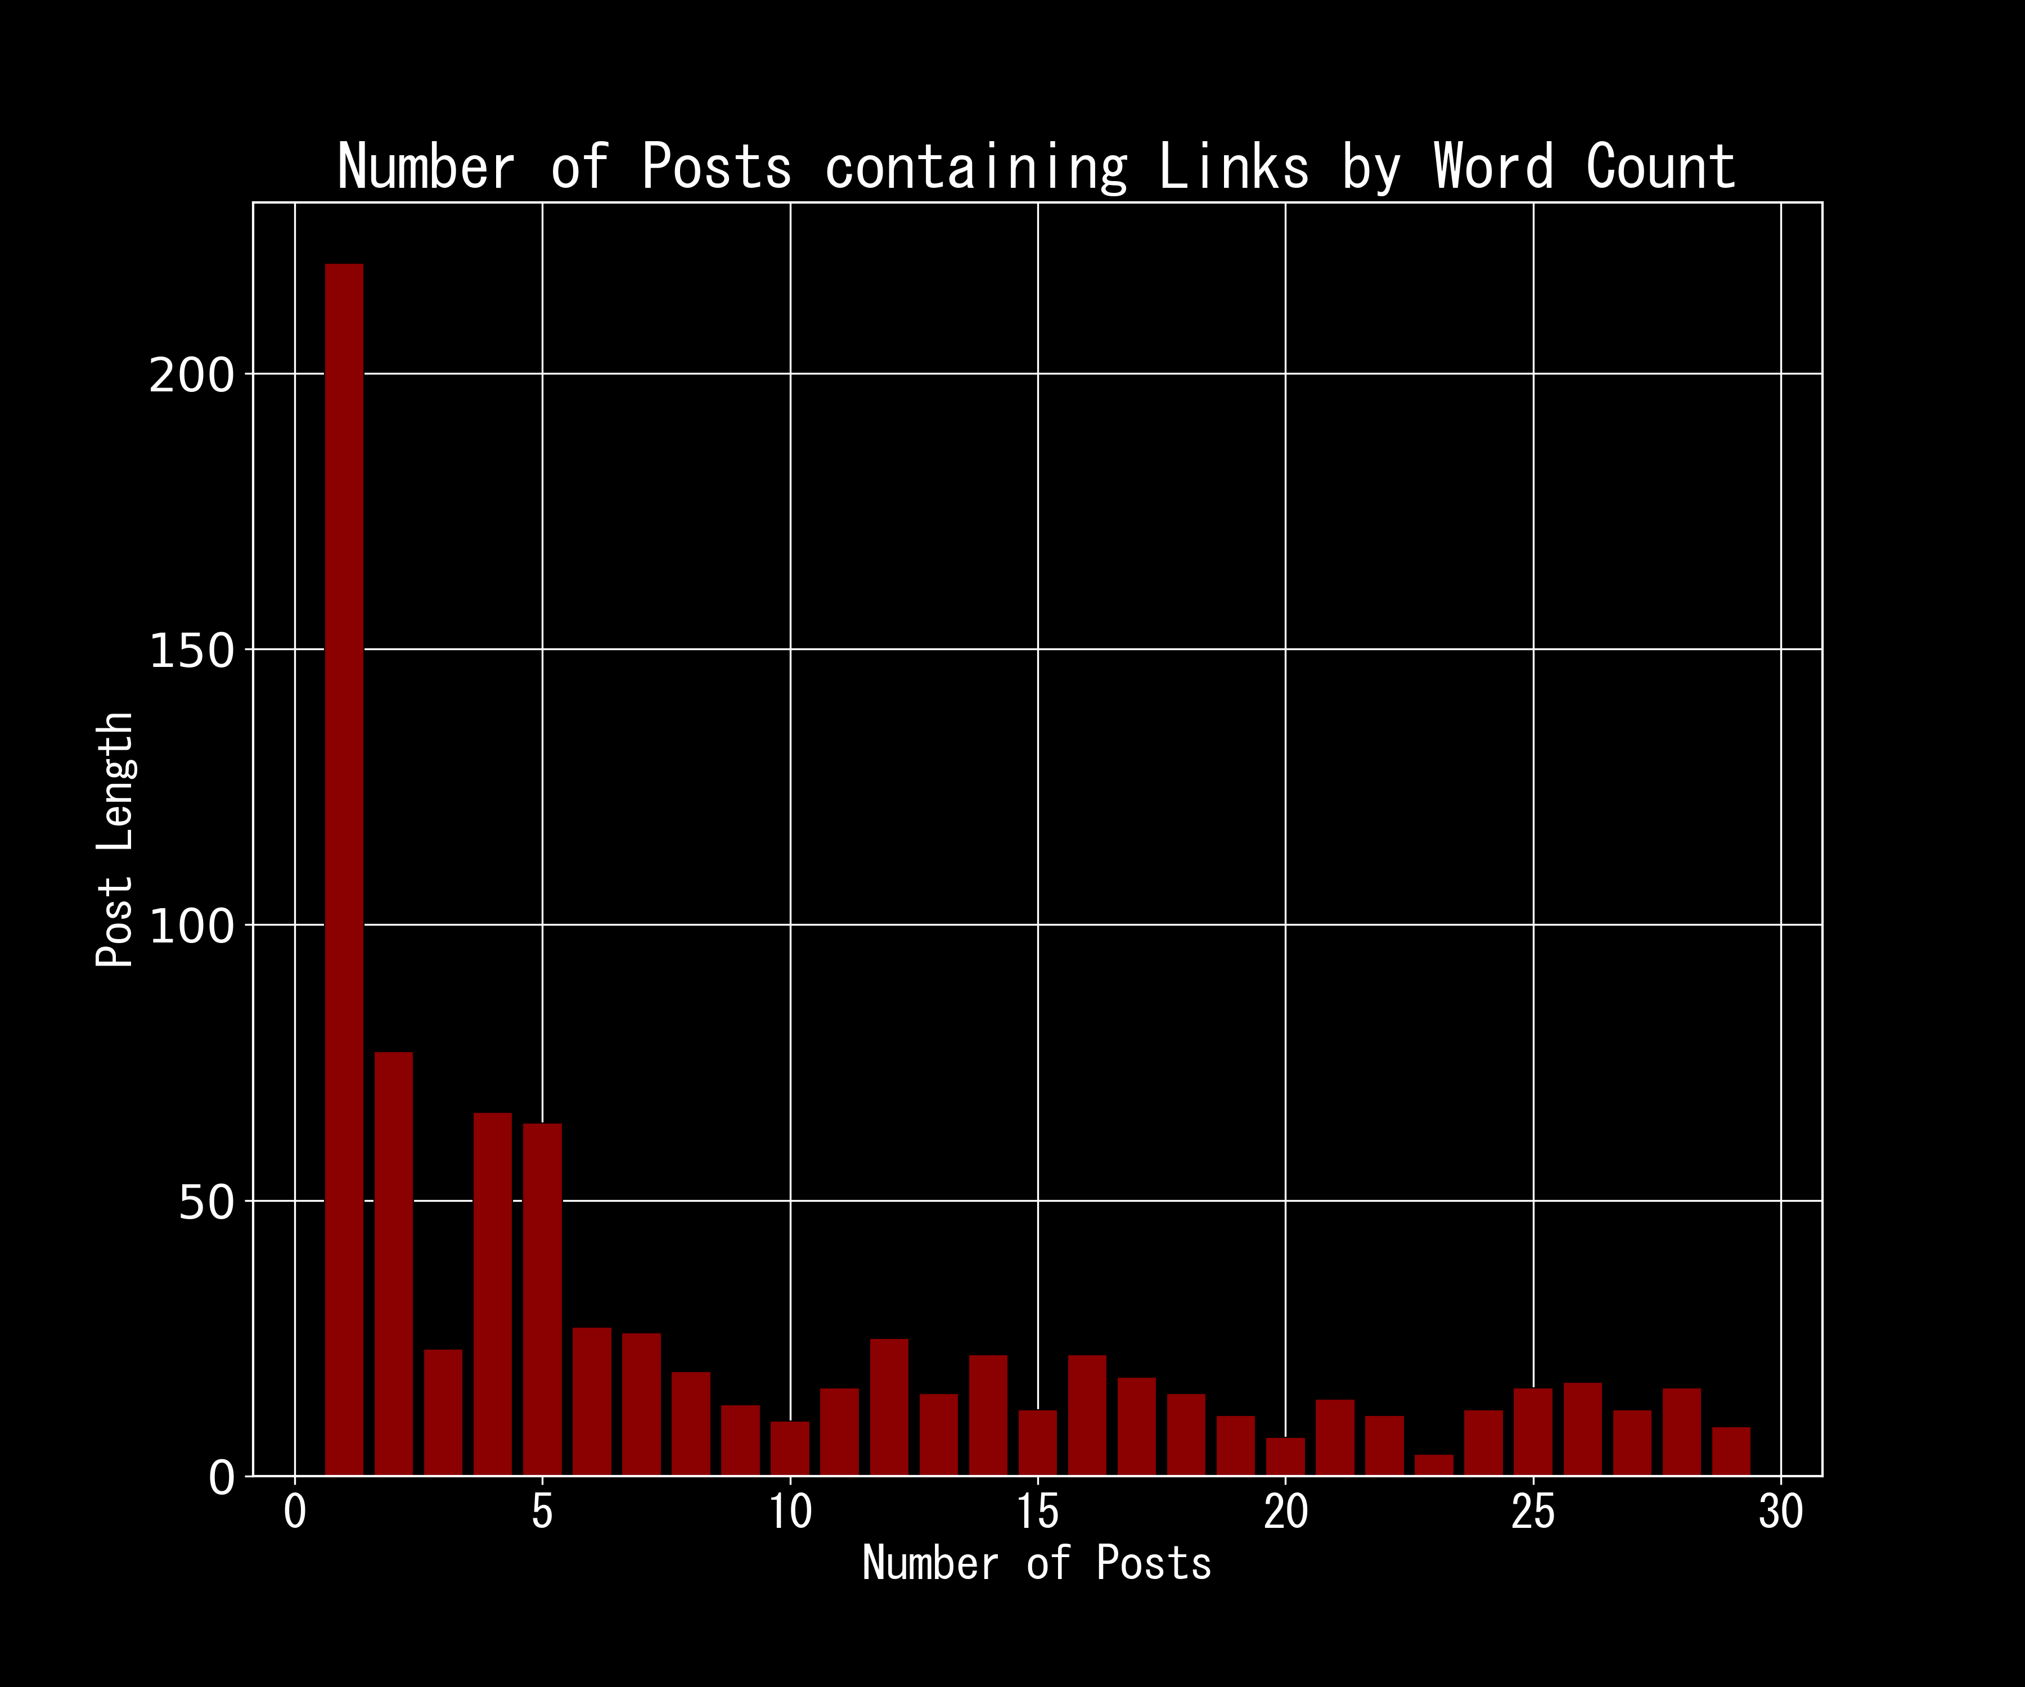
Our Data
Scraped 5000 posts from Reddit
Pushshift API
2500 from r/punk
2500 from r/poppunkers
A lot of single-word posts
Links
Deleted posts
Notes:
Pushshift is an API specifically for scraping reddit posts

Slide 6
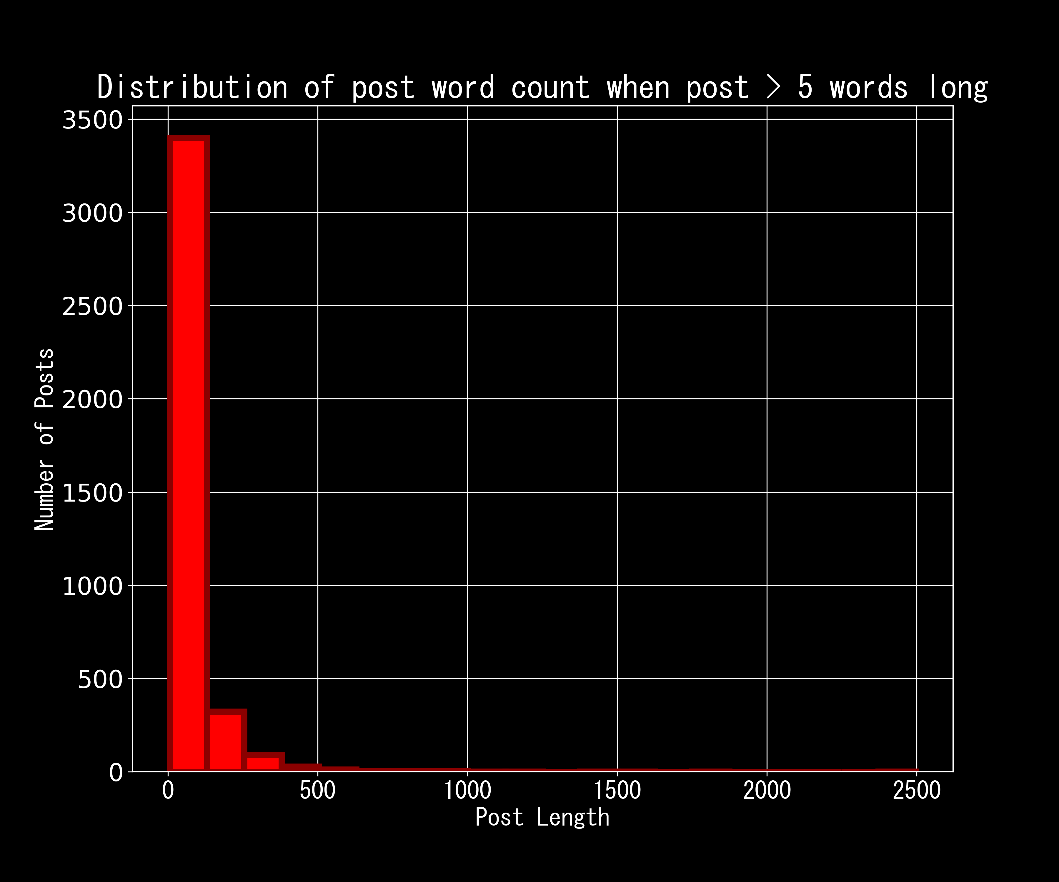
Our Data
Post length is skewed right

Slide 7
Our Data
5 most common words across both r/punk and r/poppunkers
WORD | COUNT
Punk | 2972
Band | 2161
Get | 918
Pop | 894
One | 838
Notes:
These words will end up having a lot of influence on our model because they make up so much of the corpus

Slide 8
Our MODEL

Slide 9

Our Model
Tested out three different models
Multinomial Naïve Bayes
Logistic Regression
Support Vector Machine
Tested the models with two different vectorizers
Count Vectorizer
Tfidf Vectorizer
Grid searched across them to find the best scores
Notes:
In order to arrive at our production model, we tested out three different kinds of models on our data
We grid searched across these three models with different

Slide 10
Gr idsear ch R esults
Test Number | model | cvec__ngram_range | tvec__ngram_range | train_score | test_score
1 | LogisticRegression(max_iter=2000) | (1, 2) |  | 0.788779 | 0.830721
3 | LogisticRegression(max_iter=2000) | (1, 2) |  | 0.787733 | 0.831766
5 | LogisticRegression(max_iter=2000) | (1, 2) |  | 0.787733 | 0.831766
2 | MultinomialNB() | (1, 2) |  | 0.812131 | 0.832811
4 | MultinomialNB() | (1, 2) |  | 0.812131 | 0.832811
0 | MultinomialNB() | (1, 2) |  | 0.811783 | 0.834901
6 | SVC(degree=2, kernel='poly') |  | (1, 1) | 0.793301 | 0.807732
7 | SVC(degree=2, kernel='poly') |  | (1, 1) | 0.793301 | 0.807732
8 | SVC(degree=2, kernel='poly') |  | (1, 1) | 0.793301 | 0.807732
*other params searched over included max df, and max_features
Notes:
We did search across other parameters here, but they weren’t included in this table. You can see that the Support Vector Classifier does better with a smaller ngram range vs. the Multinomial Naïve Bayes and Logistic Regression models. Ultimately, the scores were pretty close, but we ended up choosing test number 4 as our production model

Slide 11

Our Model
INTERPRETABility
Performance
Preprocessing
Count Vectorizer transformer with a Multinomial Naïve Bayes l classifier
Notes:
Why did we choose this model?

Slide 12

Per for mance
Baseline model: 50% accurate
Cvec + Naïve Bayes Multinomial: 83.3% accurate on testing data

Slide 13
Our Findings

Slide 14
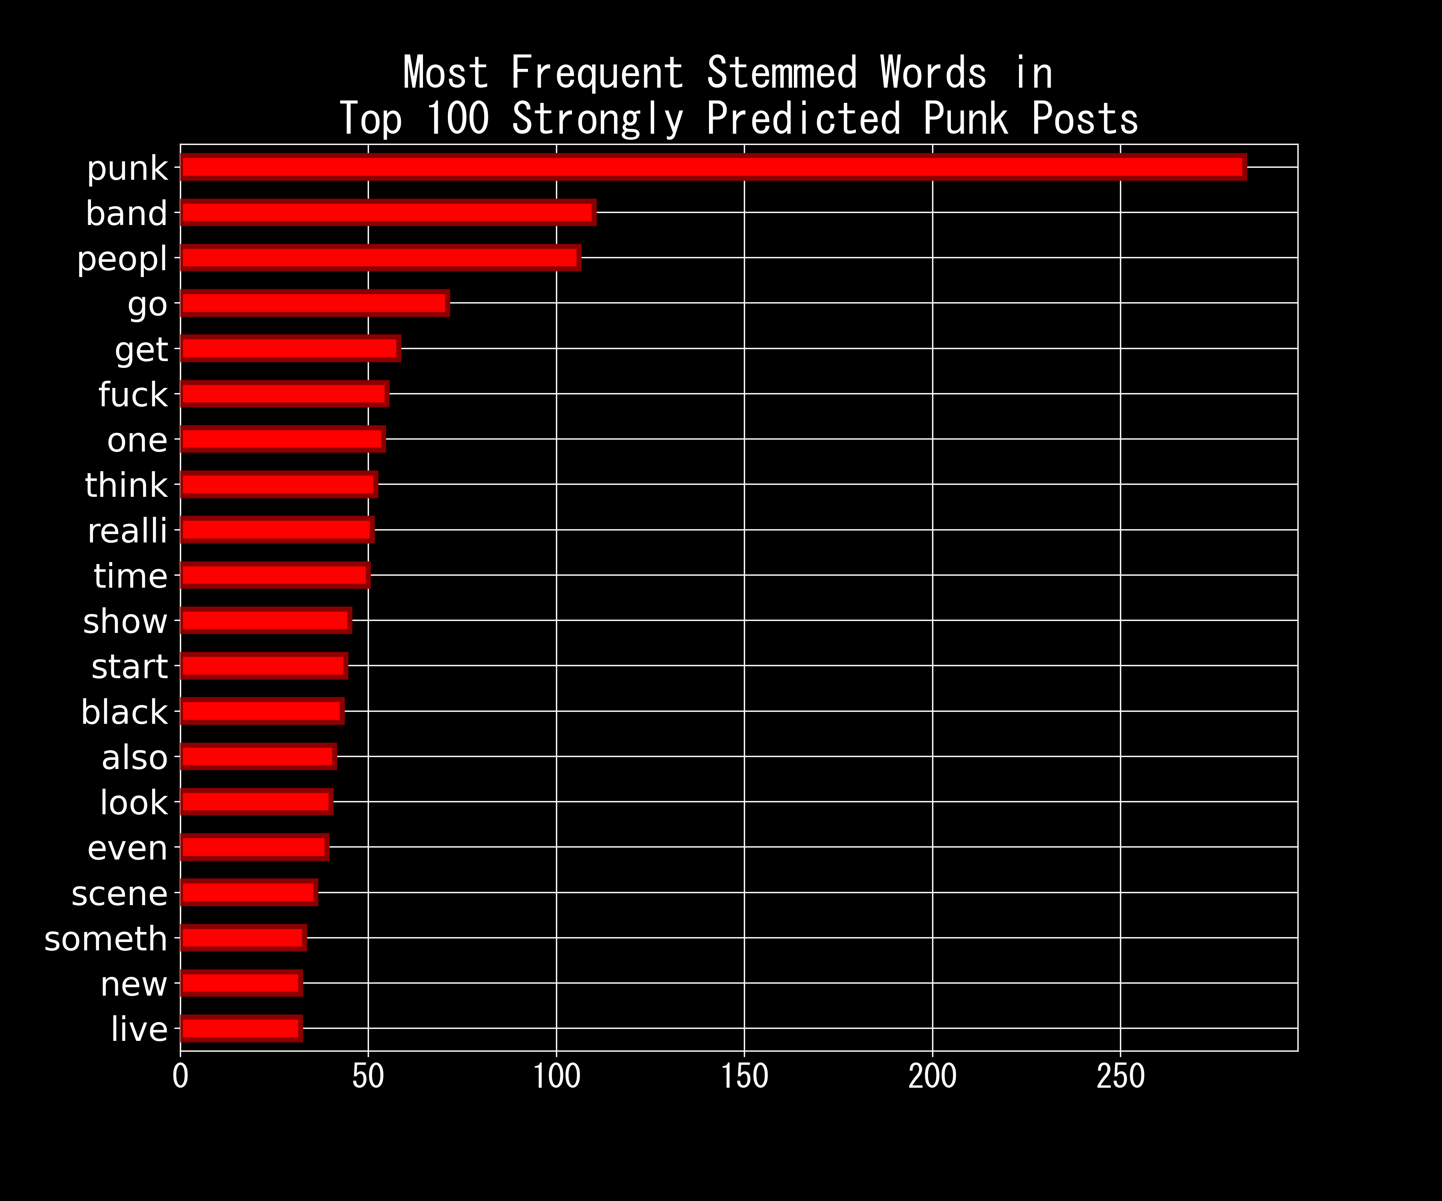
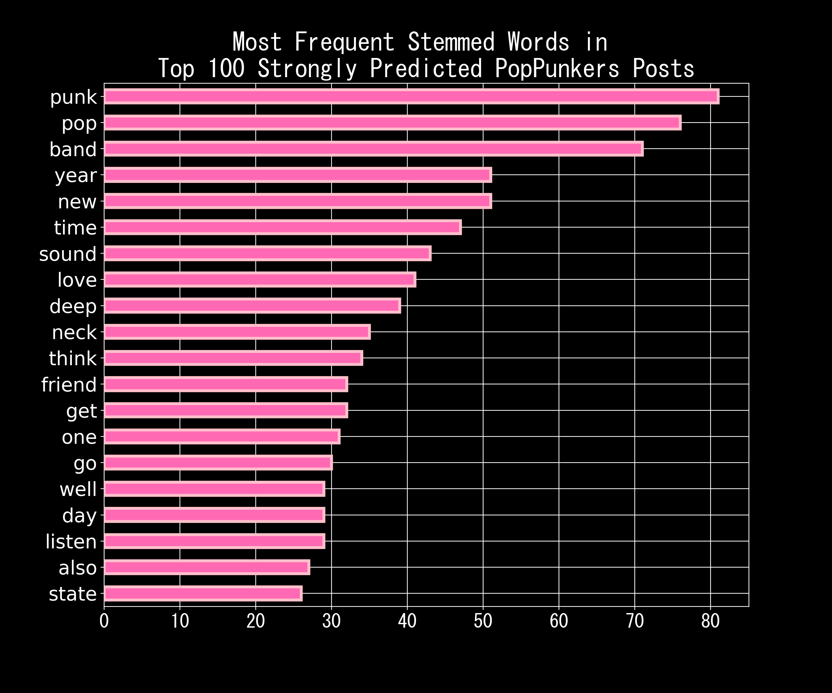
Findings
Notes:
We can't make any strong conclusions about the words here, but it is interesting to see that there aren't many band names in the top 20 for each category, except for maybe Black Flag in the Punk Subreddit, but there seem to be a mix of posts about black flag AND posts about the Black Lives Matter movement.
Something interesting to note is that 'love' and 'friend' pop up frequently in the posts that had the highest predictions of being in the PopPunkers subreddit, wheras those words are not to be found in the top 20 words in the Punk subreddit.

Slide 15
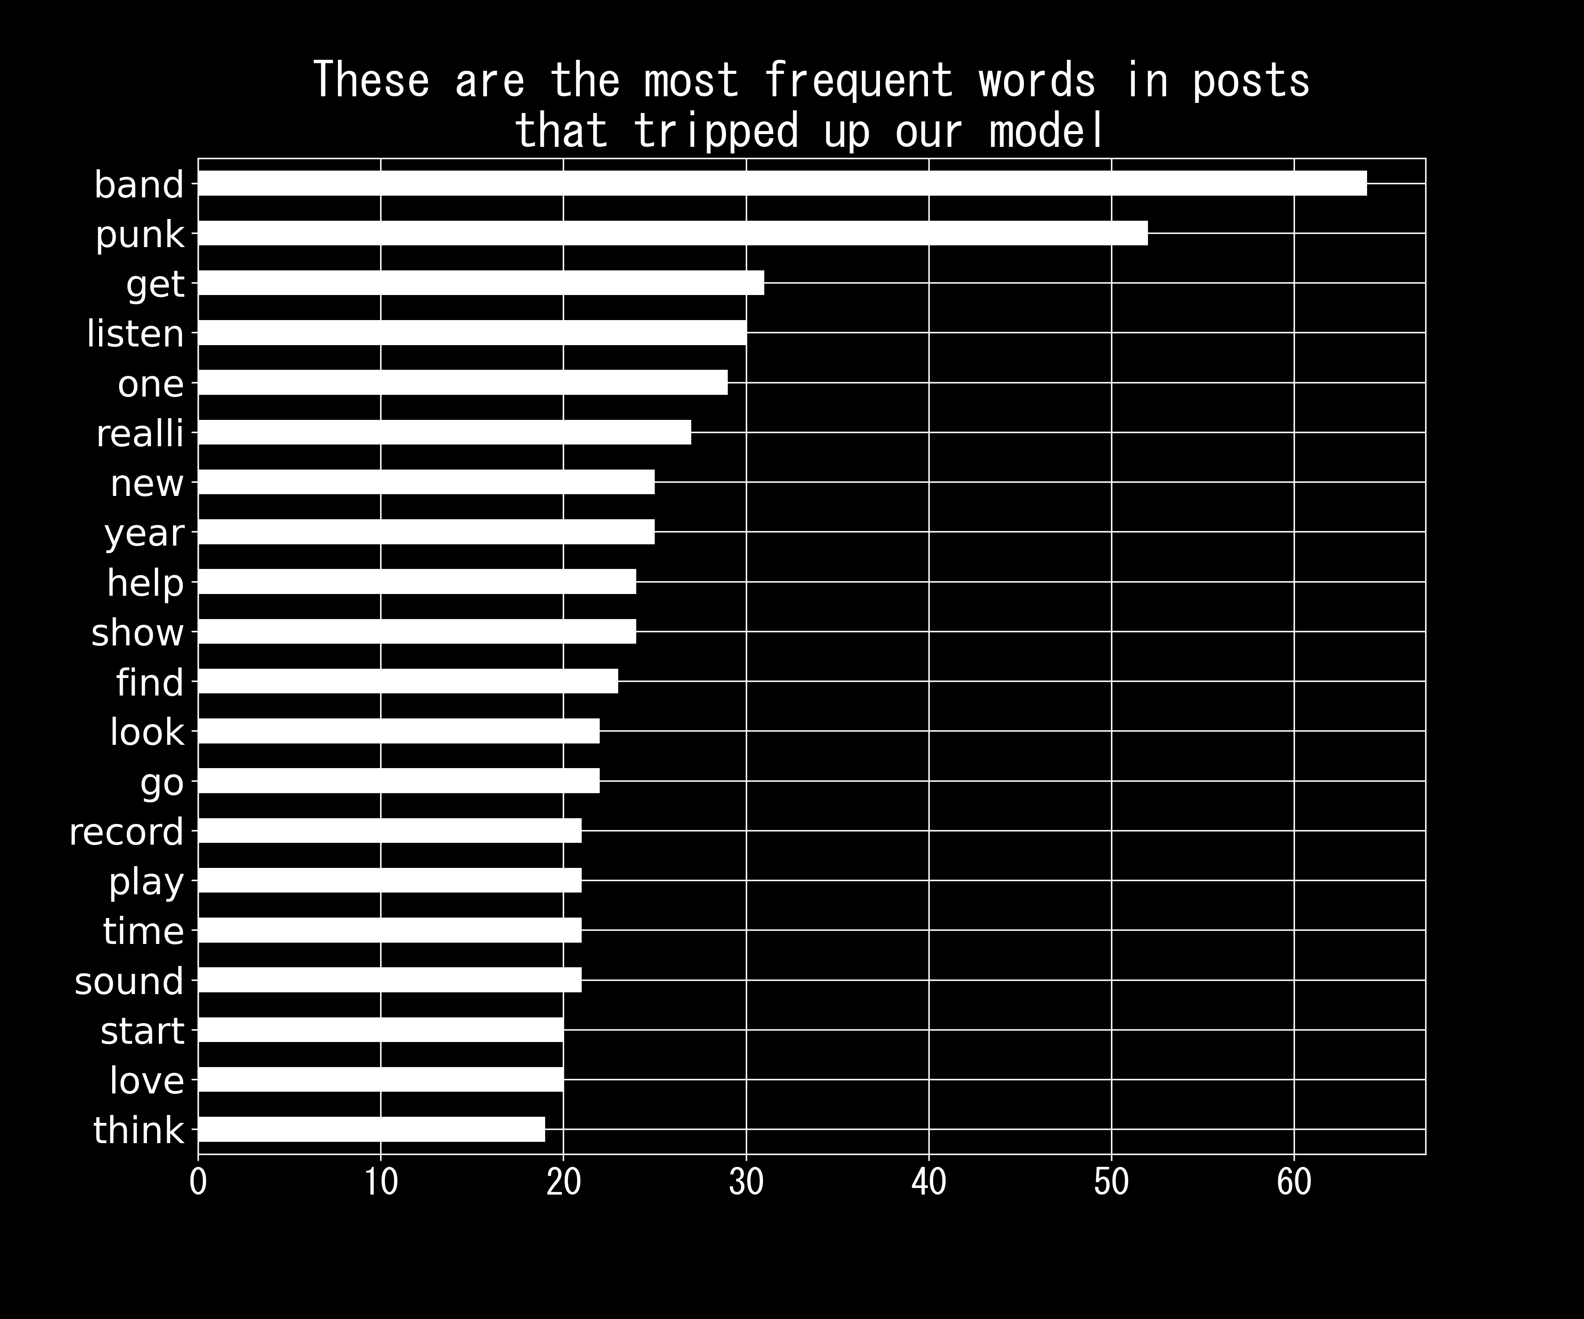
Findings
Notes:
Looking at this visual, it seems like there are quite a few words that intersect between the subreddits. Let's see what our model determined the predictive power of some of these words to be.
These are similar to the most frequent words in the entire corpus

Slide 16
Conclusions

Slide 17
Conclusions
Model outperforms baseline
Small overlap between subreddits
Marketing and Messaging
Notes:
The model outperforms the baseline by ~30%, this means that it does a fairly good job of predicting whether posts come from one subreddit or another.
But this doesn’t mean that the subreddits PopPunkers and Punk are completely separate groups. There is some overlap between them that trips up our Multinomial Naive Bayes model. Most notably, the words 'punk' and 'band' seem to be used regularly in both subreddits.
Now that we have this model built out, it could be useful for targeted marketing and messaging purposes if further exploration and analysis is conducted on the topics and words most commonly used in the subreddits that we determine as being important or adjacent to a band or genre.

Slide 18
Thank You

